Slide 1
VaxStats Repository
LIS 598 J with Dr. Nic Weber
Alexis McClimans, Karalyn Ostler, Kaitlin Throgmorton

Slide 2
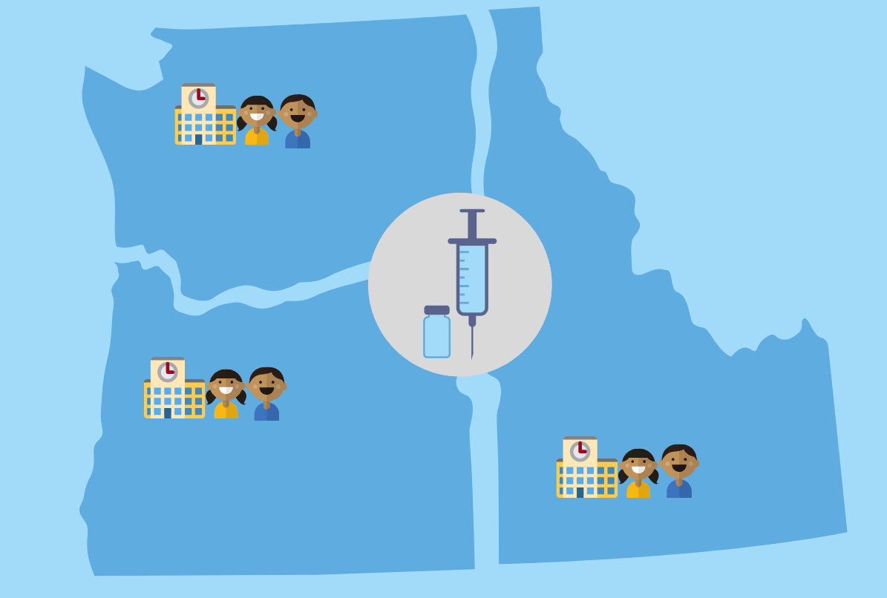
Brief Overview
VaxStats is an open vaccination data repository for the PNW.
It provides vaccination and immunization data about school-age children in the Pacific Northwest states of Idaho, Oregon, and Washington.

Slide 3
Repository Goals
To fully understand how vaccination rates and disease outbreaks are related, and in order to prevent them in future, the VaxStats repository aims to:
Provide a central repository for all vaccination data on school age children in the PNW, as well as related data like outbreak data and policy data
Establish collection standards that allow disparate vaccination datasets to be discovered and compared
Allow users to visualize multiple layers of data at once, through curation of data to improve interoperability and machine readability

Slide 4
User Community
Health officials and medical professionals
Education administrators, teachers, students, and parents of students
Policy analysts, legislators, and other citizen interest groups
Researchers and nonprofit groups
Journalists
General public

Slide 5
User Community Features
This user community comes with some unique constraints, including:
Legal constraints
Vaccination law varies from state to state, ranging from stringent to lax
Privacy constraints
Most vaccination data is medical in nature, making it subject to rigid privacy protections
Interoperability constraints
Because of the two constraints above, no state is producing vaccination data in the same way, making interoperability challenging

Slide 6
User Community: Data Requirements
User Group | Data Access | Data Format | Data Analysis
Department of Health | API, File download, GUI browsing | Plain text, non-encoded CSV | See full picture of vaccination data for their area
School Administrator | File download, GUI browsing | Open formats, not specific | Track school vaccination data over time, and compare data from surrounding districts
Policy Analyst | API, File download, GUI browsing | Plain text, non-encoded CSV | View historical and multi-region data, as well as visualize it
Journalist | File download, GUI browsing | Open formats, not specific | Find data easily, read data descriptions, and visualize data
Epidemiologist | API, File download, GUI browsing | Plain text, non-encoded CSV | Load data into statistical processing software and compare with other data
General Public | GUI browsing | Open formats, not specific | Find and browse data quickly and easily

Slide 7
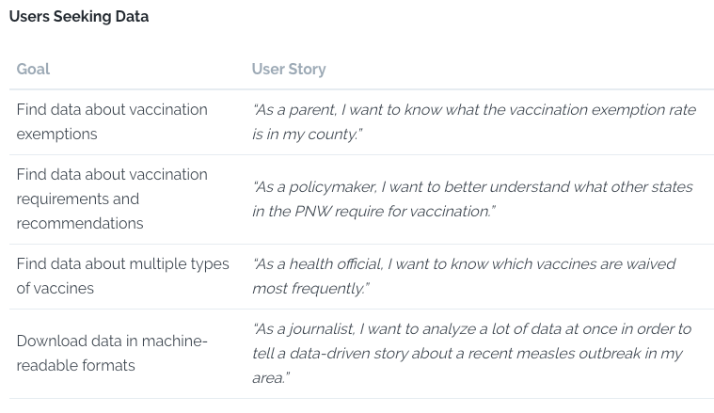
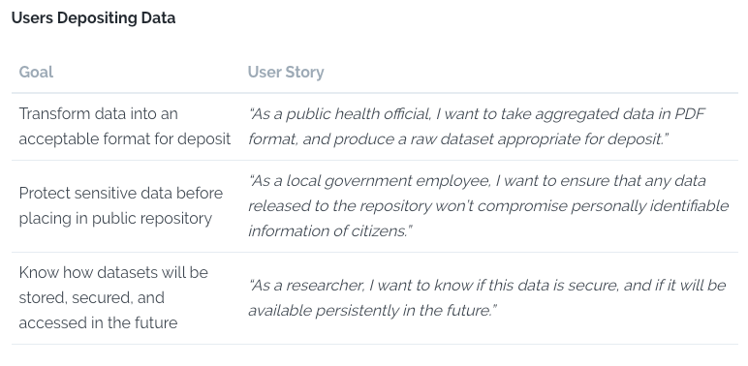
User Community: User Stories

Slide 8
User Community Design Choices
We predicted our user community to be relatively large and diverse, because disease prevention, and thus vaccination and immunization, affects entire communities. To account for this, we included both data access requirements and user stories broken down by individual user categories.
We also spent considerable time reviewing the various constraints entailed by this data, especially applicable laws, and decided to include a full legislative overview in our protocol, as well as specifications for the creation of a legislative tracker that would also be part of our repository.

Slide 9
Collection Policy
Submissions-based repository with light curatorial services offered
Only accepts data about required vaccinations and immunization schedules for school-age children in the PNW states of ID, OR, and WA
Design choices:
Because of the complex nature of medical vaccination data, the repository is submissions-based with only light-touch curation.
While data about non-required vaccines and adult vaccines exists, it tends to be less complete than data about required vaccines for children. Additionally, immunization for the most severe vaccine-preventable diseases almost exclusively occurs in childhood.

Slide 10
Ingest Policy
VaxStats data must be:
Machine-Readable
Human-Readable
Licensed
Secure
Verified
Design choices:
We sought to strike a balance here between making the repository data open access while also ensuring that we protect the sensitive populations our data is about.

Slide 11
Deposit Policy
To deposit data with Vax Stats:
Prepare data for deposit
Ensure data is complete, correct, and well-documented
Submit data and all accompanying documentation
Policy also includes:
File formatting tips
Data cleaning tips
Information about VaxStats’ data quality tiers
Document conversion to machine-readable formats, e.g. Tabula, R, Python

Slide 12
Deposit Policy
Design choices:
Our deposit policy heavily emphasizes documentation (data descriptions, metadata, data dictionaries) in order to demystify the confusing nature of medical data. Vaccination data comes riddled with unexplained acronyms and complicated terminology, so data deposits must be well-explained for the lay user (and non-medical curator).
The deposit policy also insists on machine-readable file formats and cleaned data to aid in interoperability. As the repository seeks to make interstate vaccination data more findable, accessible, and reusable, both human-readable and machine-readable data is essential.

Slide 13
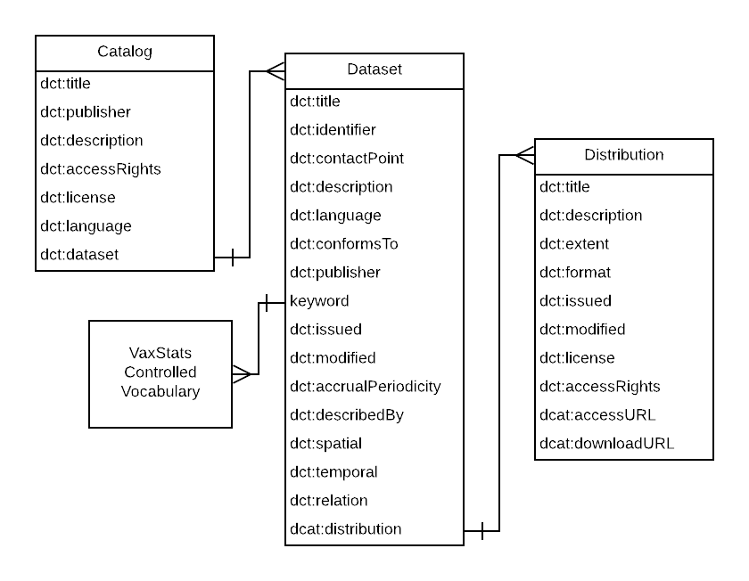
Metadata: Application Profile
VaxStats’ metadata schema is modeled according to the Data Catalog Vocabulary (DCAT), an RDF vocabulary which uses terminology from the Dublin Core Terms vocabulary. It is intended for use in government repositories, and was especially suited to the needs of VaxStats user community.

Slide 14
Metadata: Controlled Vocabulary
An additional controlled vocabulary was needed to exert control over the keywords that were used to describe submissions. As the terminology used to describe submissions was largely medical in nature, VaxStats’ leveraged the MeSH vocabulary provided by the National Library of Medicine to control potential keywords. For each individual keyword, there are SKOS preferred and alternate terms that facilitate expanded search, as well as provide control over term assignment.
Terms include:
Diphtheria, DT (VACCINE), DTaP (VACCINE), DTP (VACCINE), Hep A, Hep B, HiB, HPV (VACCINE), Immunization, IPV (VACCINE), Measles virus, Meningococcal, MMR (VACCINE), Mumps virus, NIS, PCV, Pertussis, Polio, PV, Rubella Virus, Tdap, Tetanus, Vaccination, Varicella, Varicella (VACCINE)

Slide 15
Datasets
Data from source:
File Format:
7 Excel Books (.xlsx)
11 PDF files
Content:
Mix of documentation and datasets
Multiple values per cell
No standardized formatting
Converted data for deposit:
File Format:
61 .csv files
Content:
Only data from tables
One table per file
Machine readable
Columns: variables
Rows: observations
Separated documentation

Slide 16
Data Conversion
To convert the PDF locked data into a machine readable form, we used the browser based tool Tabula.
Steps:
Use Tabula to convert as much data as possible from PDF table
Export each table in file as a separate .csv file
Open using spreadsheet software or text editor
Add in data lost in conversion (e.g. vertical text, multiple values in one cell)
Add original file name, table name, source information to README file
Save extra documentation in PDFs or Excel as separate PDF files

Slide 17
Conclusion
VaxStats GitHub repository
VaxStats Gitbook protocol (full written report)

